Slide 1
CS210
Algorithms and Data Structures
Stacks and Queues
Week 7
Semester 1 2025
Dr. Pierpaolo Dondio

Slide 2
Week 7
Stacks: definition and functioning
Built-in Java classes
Examples in Java
Queues: definition and functioning
Built-in Java classes
Examples in Java
The Process scheduling problem

Slide 3
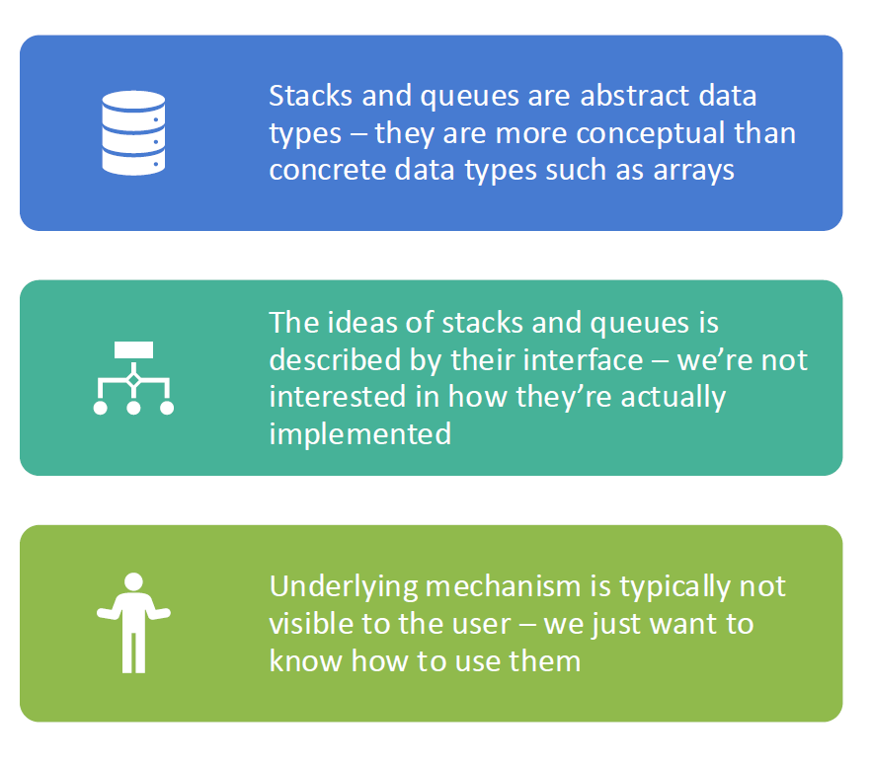
Stacks and Queues

Slide 4
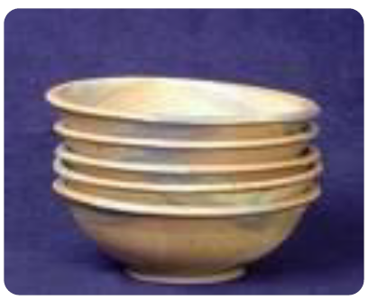
Stack
A stack is a linear data structure able to store a collection of objects in the LIFO order.
The first element added to the stack is the first to be removed. If I want to remove the second-last added elements, I first need to remove the last added one.
If I want to remove the first added element, I need to remove all the elements (empty the stack)
Stacks are also referred to as pushdown stack or pushdown list

Slide 5
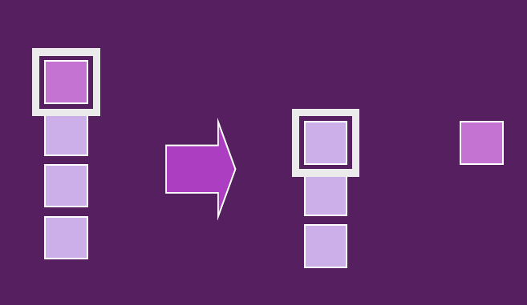
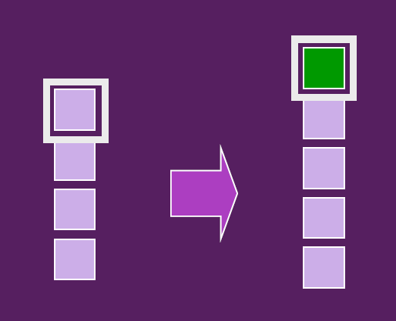
Stack // Methods
Operation | Description | Example
push() | Add (insert) an element on top | Push 10
pop() | Remove (delete) the top element | Pop → 10
peek() | View the top element (without removing it) | Peek → 10
isEmpty() | Check if the stack is empty | true/false
search() | Search for an element in the stack | returns position
Push, pop and peek they all have complexity O(1)
Searching in a stack requires a linear search (i.e. linear complexity O(n) )
POP()
PUSH()

Slide 6
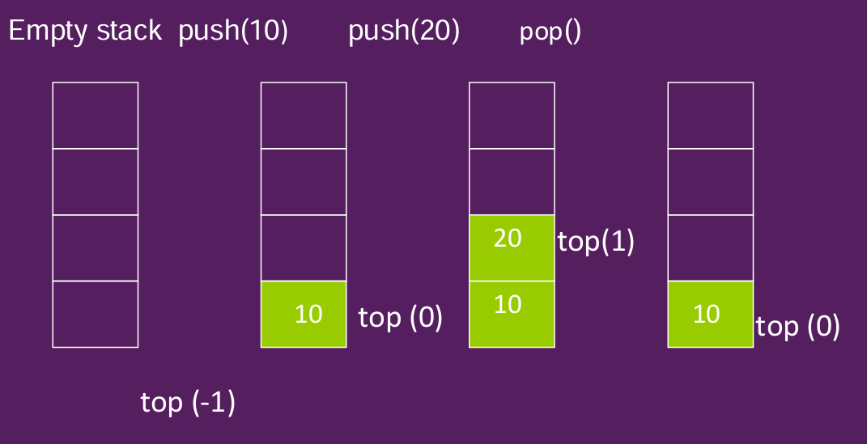
Stacks in Java using simple Arrays
Ideas:
We need to keep a variable with the index of the element at the top of the stack, used to remove the top element or add a new element
We need to create a Java Class with the following methods:
  Push()
  Pop()
  Peek()
  isEmpty()
We will also add the method isFull() and a method to display the content of the stack

Slide 7
Stacks in Java Using Arrays / 1
Below are the attributes and the constructor for the Class StackUsingArray, implementing a stack data structure using Java Arrays.
Top is the index to the top element (the last one that was added.
When a new object stack is created, we need to pass the maximum size of the stack
public class StackUsingArray {
private int maxSize; // maximum capacity of stack
private int[] stackArray; // array to store elements
private int top; // index of top element
// Constructor
public StackUsingArray(int size) {
maxSize = size;
stackArray = new int[maxSize];
top = -1; // stack is initially empty}

Slide 8
Stacks in Java Using Arrays / Methods
// Check if stack is empty
public boolean isEmpty() {
return (top == -1);
}
// Check if stack is full
public boolean isFull() {
return (top == maxSize - 1);
}
// Push operation: add element to the top
public void push(int value) {
if (isFull()) {
System.out.println("Stack Overflow! Cannot push " + value);
return;
}
stackArray[++top] = value;
System.out.println(value + " pushed to stack.");
}

Slide 9
Stacks in Java Using Arrays / Methods
// Pop operation: remove top element
public int pop() {
if (isEmpty()) {
System.out.println("Stack Underflow! Cannot pop.");
return -1; // or throw exception
}
return stackArray[top--];
}
// Peek operation: view top element
public int peek() {
if (isEmpty()) {
System.out.println("Stack is empty.");
return -1;
}
return stackArray[top];
}

Slide 10
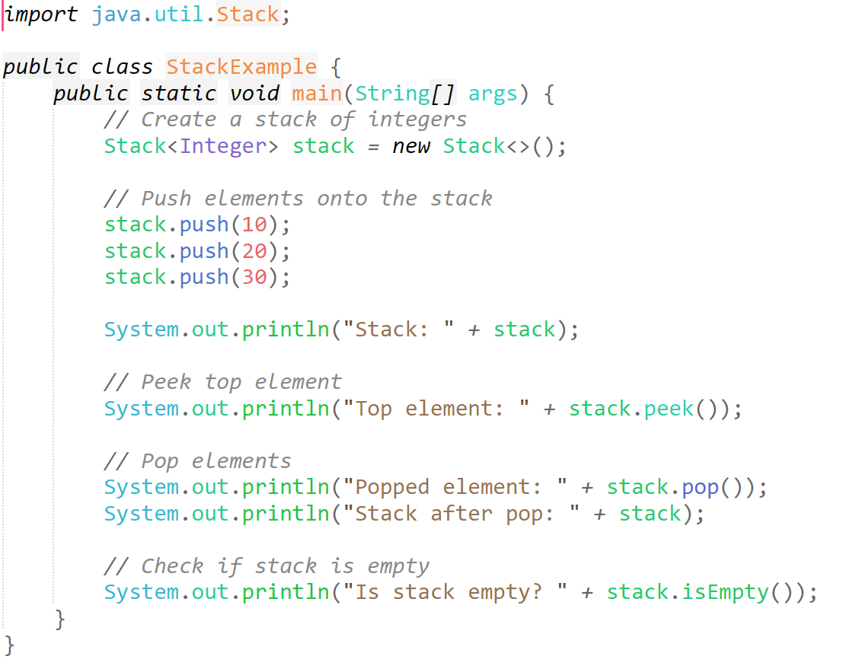
Built-in Stack classes
Using Built-in class
java.util.Stack

Slide 11
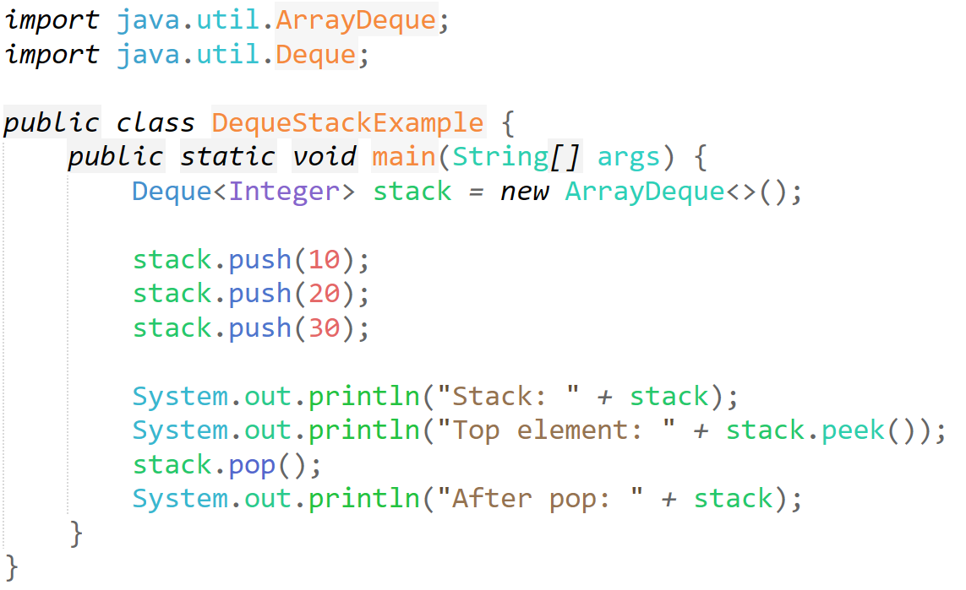
Built-in Stack classes
Using Built-in classes
java.util.ArrayDeque
Java.util.Deque

Slide 12
Where are stacks used?
The most used way of organizing computer memory
When a program is running, the last function to be executed is the first to be completed
…
main()
foo(bar())
end.
Parsers for expressions and programming languages
Recursion
Undo/Redo implementation, Web browser navigation
main
bar
main
foo
bar
main
bar
main
main

Slide 13
How would you exit a maze?
Can you think about an algorithm to exit a maze (that is, starting from the entrance, you have to reach the exit?
What is the algorihm? What moves are allowed?
Do I need a data structure?
 | 1 |  | 7
 | 2 | 5 | 6
 | 3 |  | 8 | 10
 | 4 |  | 9

Slide 14
An example: exiting a maze
Algorithm
Go Down, add the step to a stack-like memory
If Wall, go left , add the step to a stack-like memory
If Wall, go right , add the step to a stack-like memory
If Wall, go Up , add the step to a stack-like memory
You cannot visit a location twice, since this represents a loop, you need to find another way
If nowhere to go, go back to the previous location using the stack like memory
 | 1 |  | 7
 | 2 | 5 | 6
 | 3 |  | 8 | 10
 | 4 |  | 9

Slide 15
An example: exiting a maze
Moves:
Down : 1
Stack
1
 | 1 |  | 7
 | 2 | 5 | 6
 | 3 |  | 8 | 10
 | 4 |  | 9
Visited: 1

Slide 16
An example: exiting a maze
Moves:
Down : 1
Down : 2
Stack
2
1
 | 1 |  | 7
 | 2 | 5 | 6
 | 3 |  | 8 | 10
 | 4 |  | 9
Visited: 1,2

Slide 17
An example: exiting a maze
Moves:
Down : 1
Down : 2
Down : 3
Stack
3
2
1
 | 1 |  | 7
 | 2 | 5 | 6
 | 3 |  | 8 | 10
 | 4 |  | 9
Visited: 1,2,3

Slide 18
An example: exiting a maze
Moves:
Down : 1
Down : 2
Down : 3
Down : 4
Stack
4
3
2
1
 | 1 |  | 7
 | 2 | 5 | 6
 | 3 |  | 8 | 10
 | 4 |  | 9
Visited: 1,2,3,4

Slide 19
An example: exiting a maze
Moves:
Down : 1
Down : 2
Down : 3
Down : 4
Down : WALL
Left: WALL
Right: WALL
Up already visited (3)
Stack
4
3
2
1
 | 1 |  | 7
 | 2 | 5 | 6
 | 3 |  | 8 | 10
 | 4 |  | 9
Visited: 1,2,3,4

Slide 20
An example: exiting a maze
Moves:
Down : 1
Down : 2
Down : 3
Down : 4
Down : WALL
Left: WALL
Right: WALL
Up already visited (3)
No options: Go back to the previous stack location: 3
Stack
3
2
1
 | 1 |  | 7
 | 2 | 5 | 6
 | 3 |  | 8 | 10
 | 4 |  | 9
Visited: 1,2,3,4

Slide 21
An example: exiting a maze
Moves:
Down : 1
Down : 2
Down : 3
Down : 4
Down : WALL
Left: WALL
Right: WALL
Up already visited (3)
No options: Go back to the previous stack location: 3
Down already visited (4)
Left: WALL
Right: WALL
Up already visited (2)
Stack
3
2
1
 | 1 |  | 7
 | 2 | 5 | 6
 | 3 |  | 8 | 10
 | 4 |  | 9
Visited: 1,2,3,4

Slide 22
An example: exiting a maze
Moves:
Down : 1
Down : 2
Down : 3
Down : 4
Down : WALL
Left: WALL
Right: WALL
Up already visited (3)
No options: Go back to the previous stack location: 3
Down already visited (4)
Left: WALL
Right: WALL
Up already visited (2)
No options: Go back to the previous stack location: 2
Stack
2
1
 | 1 |  | 7
 | 2 | 5 | 6
 | 3 |  | 8 | 10
 | 4 |  | 9
Visited: 1,2,3,4,5

Slide 23
An example: exiting a maze
Moves:
Down : 1
Down : 2
Down : 3
Down : 4
Down : WALL
Left: WALL
Right: WALL
Up already visited (3)
No options: Go back to the previous stack location: 3
Down already visited (4)
Left: WALL
Right: WALL
Up already visited (2)
No options: Go back to the previous stack location: 2
Down already visited (3)
Left: WALL
Right: 5
Stack
5
2
1
 | 1 |  | 7
 | 2 | 5 | 6
 | 3 |  | 8 | 10
 | 4 |  | 9
Visited: 1,2,3,4,5

Slide 24
An example: exiting a maze
Moves:
Down: WALL
Left already visited (2)
Right: 6
Stack
6
5
2
1
 | 1 |  | 7
 | 2 | 5 | 6
 | 3 |  | 8 | 10
 | 4 |  | 9
Visited: 1,2,3,4,5,6

Slide 25
An example: exiting a maze
Moves:
Down: WALL
Left already visited (2)
Right: 6
Down: 8
Stack
8
6
5
2
1
 | 1 |  | 7
 | 2 | 5 | 6
 | 3 |  | 8 | 10
 | 4 |  | 9
Visited: 1,2,3,4,5,6,8

Slide 26
An example: exiting a maze
Moves:
Down: WALL
Left already visited (2)
Right: 6
Down: 8
Down: 9
Stack
9
8
6
5
2
1
 | 1 |  | 7
 | 2 | 5 | 6
 | 3 |  | 8 | 10
 | 4 |  | 9
Visited: 1,2,3,4,5,6,8,9

Slide 27
An example: exiting a maze
Moves:
Down: WALL
Left already visited (2)
Right: 6
Down: 8
Down: 9
Down: WALL
Left: WALL
Right: WALL
Up already visited (8)
Stack
9
8
6
5
2
1
 | 1 |  | 7
 | 2 | 5 | 6
 | 3 |  | 8 | 10
 | 4 |  | 9
Visited: 1,2,3,4,5,6,8,9

Slide 28
An example: exiting a maze
Moves:
Down: WALL
Left already visited (2)
Right: 6
Down: 8
Down: 9
Down: WALL
Left: WALL
Right: WALL
Up already visited (8)
No options: Go back to the previous stack location: 8
Stack
8
6
5
2
1
 | 1 |  | 7
 | 2 | 5 | 6
 | 3 |  | 8 | 10
 | 4 |  | 9
Visited: 1,2,3,4,5,6,8,9

Slide 29
An example: exiting a maze
Moves:
Down: WALL
Left already visited (2)
Right: 6
Down: 8
Down: 9
Down: WALL
Left: WALL
Right: WALL
Up already visited (8)
No options: Go back to the previous stack location: 8
Down already visited (9)
Left: WALL
Right: 10
Stack
10
8
6
5
2
1
 | 1 |  | 7
 | 2 | 5 | 6
 | 3 |  | 8 | 10
 | 4 |  | 9
Visited: 1,2,3,4,5,6,8,9,10

Slide 30
An example: exiting a maze
Moves:
Down: WALL
Left already visited (2)
Right: 6
Down: 8
Down: 9
Down: WALL
Left: WALL
Right: WALL
Up already visited (8)
No options: Go back to the previous stack location: 8
Down already visited (9)
Left: WALL
Right: 10
Down: WALL
Left already visited (8)
Right: EXIT
Stack
EXIT
10
8
6
5
2
1
 | 1 |  | 7
 | 2 | 5 | 6
 | 3 |  | 8 | 10
 | 4 |  | 9
Visited: 1,2,3,4,5,6,8,9,10

Slide 31
Examples IN JAVA
Check if parentheses are balanced
Reverse a string
All JAVA files on Moodle (Week 7)
  StackExample.java
  DequeStackExample.java
  BalancedParentheses.java
  ReverseString.java

Slide 32
Checking balanced parentheses with a stack
Algorithm
Read the string one character at the time. For each character:
  If the character = ( , push “(“ on the stack
  If the character = ) , pop “)“ from the stack, unless the stack is empty. In that case, the parentheses are not balanced.
If the stack is empty after all the characters have been processed, the parentheses are balanced
If the stack is not empty after all the characters have been processed, the parentheses are not balanced
Example:
1. ( ) ( )
2. ( ( ) ) )

Slide 33
Checking balanced parentheses with a stack
Example 1: ( ) ( )
Push (
Push (
Pop )
Pop )
(
(
(
(
All the characters have been processed, and the final STACK is EMPTY
→ parentheses are not balanced

Slide 34
Checking balanced parentheses with a stack
Example 2: ( ( )))
Push (
Push (
Pop )
Pop )
Pop )
(
(
(
(
ERROR: POP FROM AN EMPTY STACK
→ parentheses are not balanced

Slide 35
Checking balanced parentheses with a stack
Example 3: ( ) (
Push (
Pop )
Push (
(
(
All the characters have been processed, and the final STACK is NOT EMPTY
→ parentheses are not balanced

Slide 36
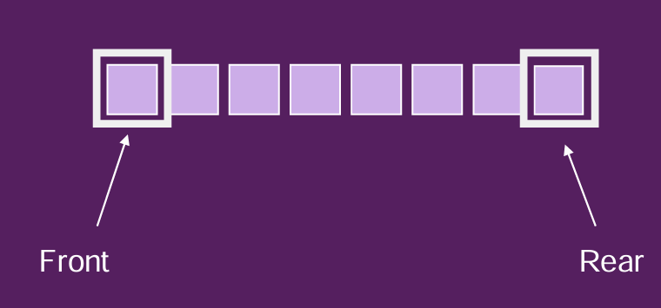
QueueS
Linear Data Structures (like Arrays or Stacks)
Queues use the First-In-First-Out system (FIFO)
The element that has been in the queue the longest is the one that is removed
Insertions are made at one end, the back of the queue
Deletions take place at the other end, the front of the queue
The front and back of the queue are called the front and rear
Queues are used everywhere e.g. printer queue, multitasking
Methods:
Push( ) is called insert, put, add or enqueue!
Pop( ) is called remove, delete, get or dequeue!
IsEmpty(), IsFull(), Size() = return the number of elements in the queue, Peek() = show the element in front of the queue

Slide 37
Queues in Java using simple arrays
(non-circular)
We need 1 variable “rear”, the index to the first empty position, after the last added element
rear=-1 (empty)
A
rear=1 (1 element in the queue, index 1 is the next available position)
A | B | C | D | E
rear=5 (5 elements in the queue, index 5 is the next available position)
B | C | D | E
rear=4 (the first element A removed, rear is decreased and I need to shift all the elements in the array)
Quite inefficient when the front element needs to be removed!!

Slide 38
Queues in Java using simple arrays (circular)
F = front
R = rear
A
Add A
A | B
Add B
A | B | C
Add C
 | B | C
Remove A
 | B | C | D
Add D
 | B | C | D | E
Add E

Slide 39
Circular Queues
A
Add A
A | B
Add B
A | B | C
Add C
 | B | C
Remove A
 | B | C | D
Add D
 | B | C | D | E
Add E
 | B | C | D | E | F
Add F
 |  | C | D | E | F
Remove B
 |  | C | D | E | F | G
Add G
H |  | C | D | E | F | G
Add H
H |  |  | D | E | F | G
Remove C

Slide 40
Queues in Java using simple arrays (circular)
Instead of moving each time all the elements in the array when the element at the front is removed, we use a circular “wraparound” way of implementing a queue
We need 2 variables (front and rear) to keep trace of the first and last element in the queue
We need to maintain some variables with our queue class
  Size of the array
  The array itself
  Variables rear and front for tracking front and rear
When an element is added, the rear is incremented by one
When an element is deleted, the front is incremented by one
When the rear (or the front) are greater than the size of the queue, they are reset to 0 (circular queue)
If the queue is full, elements cannot be added

Slide 41
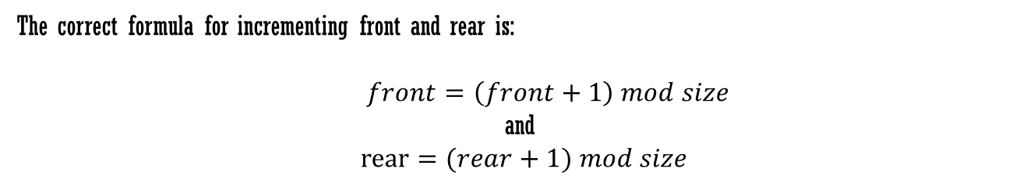
Queues in Java using simple arrays (circular)
The correct formula for incrementing front and rear is:
$front=\left(front+1\right) mod size$
and
$rear=(rear+1) mod size$
Queue Content |  |  |  |  | Front (f) | Rear (r) | Comments
 |  |  |  |  | -1 | -1 | Empty Queue
A |  |  |  |  | 0 | 0 | One element added, Rear is incremented
A | B | C | D |  | 0 | 3 | B, C Added. Rear is incremented by 3
 | B | C | D |  | 1 | 3 | Element A removed. Front is incremented
 | B | C | D | E | 1 | 4 | E Added.
 |  | C | D | E | 2 | 0 | B Removed
F |  | C | D | E | 2 | 0 | F Added, Rear is incremented by one. Since r=(4+1) mod 5 = 0, the end of the queue is reached, rear is set back to 0

Slide 42
Java Built-in classes
Several built-in classes exist, all offering the set of methods below:
Method | Description
add(E e) | Inserts element; throws exception if full
offer(E e) | Inserts element; returns false if full
remove() | Removes and returns head; throws exception if empty
poll() | Removes and returns head; returns null if empty
element() | Retrieves head without removing; throws exception if empty
peek() | Retrieves head without removing; returns null if empty

Slide 43
JAVA EXAMPLES
Built-in class ArrayDeque (ArrayDequeQueueExample.java)
Built-in class PriorityQueue (PriorityQueueExample.java)

Slide 44
Examples: the supermarket queues
Would it be better to have separate queues or one common queue?
Till 1
Till 1
Till 2
Till 2
Till 3
Till 3
Till 4
Till 4

Slide 45
One vs multiple Queues ANALYSIS
Feature | Separate Queues | Shared Queue
Load Balancing | Manual | Automatic
Fault Isolation | High | Shared risk
Scalability | Harder | Easier
Throughput | Variable | Higher
Fairness | Controlled per system | Depends on consumer speed
Management Complexity | High | Lower

Slide 46
Application of Queues: the OS Scheduler
CPU
p1 | p2 | p3 | p4 | p5
The problem of CPU scheduling in Operating System is analyzed and implemented using different queue systems
The problem
A list of processes (running programs) are in a queue, waiting to be executed by the CPU
There is only 1 CPU
A process is taken from the queue and executed fully o partially
If the process is not finished, it goes back to the queue and wait to get another CPU time slot
A process therefore can be waiting in the queue or executed in the CPU

Slide 47
Preemptive and Nonpreemptive Scheduling
When a process gets the CPU access, and we always wait for the process to be completely executed, the scheduling algorithm is call nonpreemptive. Under Nonpreemptive scheduling, once the CPU has been allocated to a process, the process keeps the CPU until it terminates
Otherwise, if a process running in the CPU can be stopped and send back to the waiting queue (and therefore the process was only partially executed) the scheduling algorithm is called preemptive.
Virtually all modern operating systems including Windows, MacOS, Linux, and UNIX use preemptive scheduling algorithms.
When a process is switched from the waiting queue to the CPU and viceversa some extra overhead is done by the operating system to save the status of the process. This is called the displatch latency

Slide 48
Scheduling Criteria
CPU utilization – keep the CPU as busy as possible
Throughput – # of processes that complete their execution per time unit
Turnaround time – amount of time to execute a particular process
Waiting time – amount of time a process has been waiting in the ready queue
Response time – amount of time it takes from when a request was submitted until the first response is produced.

Slide 49
Scheduling Algorithm Optimization Criteria
Max CPU utilization
Max throughput
Min turnaround time
Min waiting time
Min response time

Slide 50
First- Come, First-Served (FCFS) Scheduling
Process Burst Time
P₁ 24
P₂ 3
P₃ 3
Suppose that the processes arrive in the order: P₁ , P₂ , P₃
The Gantt Chart for the schedule is:
Waiting time for P₁ = 0; P₂ = 24; P₃ = 27
Average waiting time: (0 + 24 + 27)/3 = 17

Slide 51
FCFS Scheduling (Cont.)
Suppose that the processes arrive in the order:
P₂ , P₃ , P₁
The Gantt chart for the schedule is:
Waiting time for P₁ = 6; P₂ = 0; P₃ = 3
Average waiting time: (6 + 0 + 3)/3 = 3
Much better than previous case
Convoy effect - short process behind long process
  Consider one CPU-bound and many I/O-bound processes

Slide 52
Shortest-Job-First (SJF) Scheduling
Associate with each process the length of its next CPU burst
  Use these lengths to schedule the process with the shortest time
SJF is optimal – gives minimum average waiting time for a given set of processes
Preemptive version called shortest-remaining-time-first
How do we determine the length of the next CPU burst?
  Could ask the user
  Estimate

Slide 53
Example of SJF
Process Burst Time
P₁ 6
P₂ 8
P₃ 7
P₄ 3
SJF scheduling chart
Average waiting time = (3 + 16 + 9 + 0) / 4 = 7

Slide 54
Shortest Remaining Time First Scheduling
Preemptive version of SJN
Whenever a new process arrives in the ready queue, the decision on which process to schedule next is redone using the SJN algorithm.
Is SRT more “optimal” than SJN in terms of the minimum average waiting time for a given set of processes?

Slide 55
Example of Shortest-remaining-time-first
Now we add the concepts of varying arrival times and preemption to the analysis
Process i Arrival TimeT Burst Time
P₁ 0 8
P₂ 1 4
P₃ 2 9
P₄ 3 5
Preemptive SJF Gantt Chart
Average waiting time = [(10-1)+(1-1)+(17-2)+(5-3)]/4 = 26/4 = 6.5

Slide 56
Round Robin (RR)
Each process gets a small unit of CPU time (time quantum q), usually 10-100 milliseconds. After this time has elapsed, the process is preempted and added to the end of the ready queue.
If there are n processes in the ready queue and the time quantum is q, then each process gets 1/n of the CPU time in chunks of at most q time units at once. No process waits more than (n-1)q time units.
Timer interrupts every quantum to schedule next process
Performance
  q large ⇒ FIFO (FCFS)
  q small ⇒ RR
Note that q must be large with respect to context switch, otherwise overhead is too high

Slide 57
Example of RR with Time Quantum = 4
Process Burst Time
P₁ 24
P₂ 3
P₃ 3
The Gantt chart is:
Typically, higher average turnaround than SJF, but better response
q should be large compared to context switch time
  q usually 10 milliseconds to 100 milliseconds,
  Context switch < 10 microseconds

Slide 58
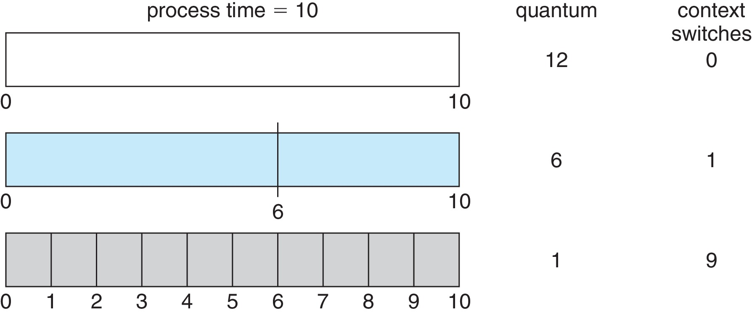
Time Quantum and Context Switch Time

Slide 59
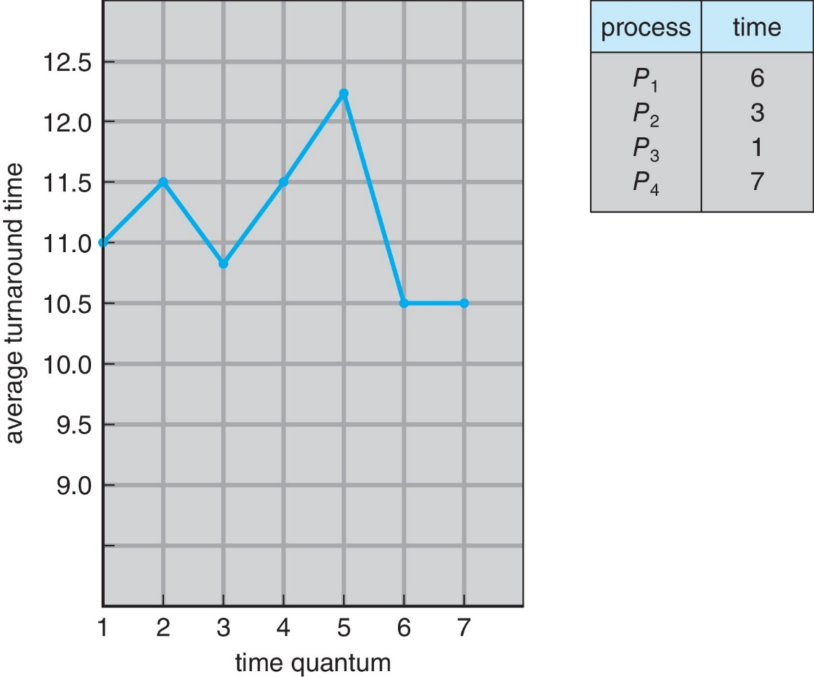
Turnaround Time Varies With The Time Quantum
80% of CPU bursts should be shorter than q

Slide 60
Priority Scheduling
A priority number (integer) is associated with each process
The CPU is allocated to the process with the highest priority (smallest integer ≡ highest priority)
  Preemptive
  Nonpreemptive
SJF is priority scheduling where priority is the inverse of predicted next CPU burst time
Problem ≡ Starvation – low priority processes may never execute
Solution ≡ Aging – as time progresses increase the priority of the process

Slide 61
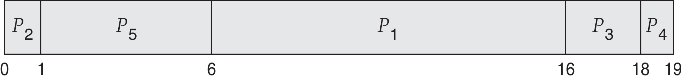
Example of Priority Scheduling
Process Burst Time Priority
P₁ 10 3
P₂ 1 1
P₃ 2 4
P₄ 1 5
P₅ 5 2
Priority scheduling Gantt Chart
Average waiting time = 8.2

Slide 62
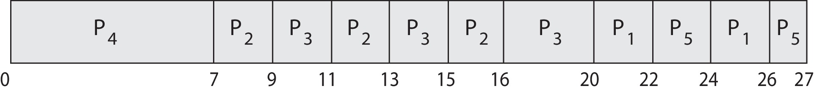
Priority Scheduling w/ Round-Robin
Run the process with the highest priority. Processes with the same priority run round-robin
Example:
Process a Burst Time Priority
P₁ 4 3
P₂ 5 2
P₃ 8 2
P₄ 7 1
P₅ 3 3
Gantt Chart with time quantum = 2

Slide 63
Multilevel Queue
The ready queue consists of multiple queues
Multilevel queue scheduler defined by the following parameters:
  Number of queues
  Scheduling algorithms for each queue
  Method used to determine which queue a process will enter when that process needs service
  Scheduling among the queues

Slide 64
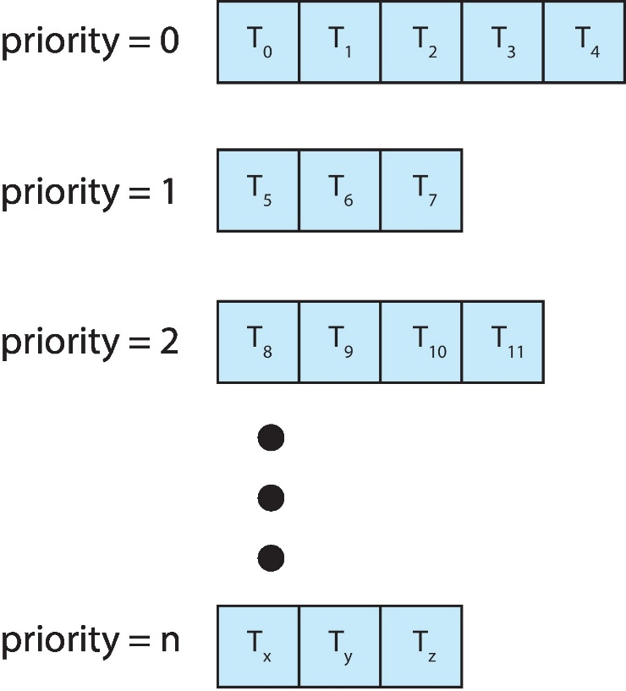
Multilevel Queue
With priority scheduling, have separate queues for each priority.
Schedule the process in the highest-priority queue!

Slide 65
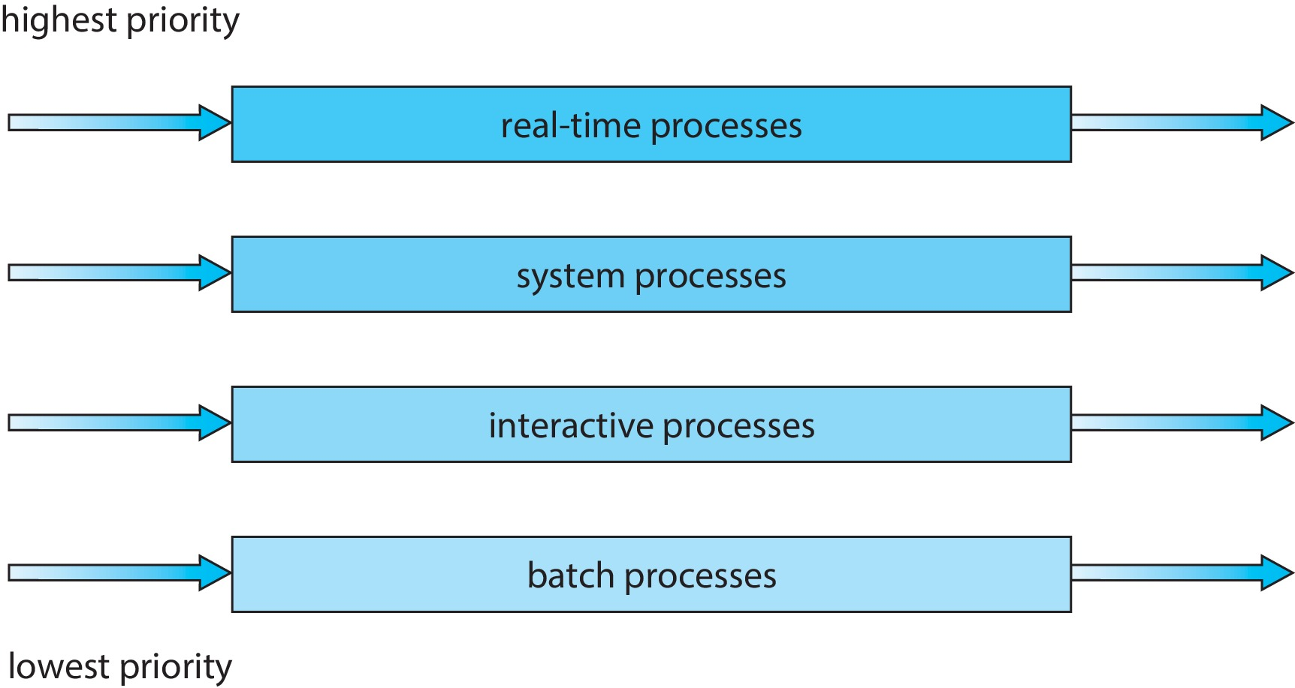
Multilevel Queue
Prioritization based upon process type

Slide 66
Multilevel Feedback Queue
A process can move between the various queues.
Multilevel-feedback-queue scheduler defined by the following parameters:
  Number of queues
  Scheduling algorithms for each queue
  Method used to determine when to upgrade a process
  Method used to determine when to demote a process
  Method used to determine which queue a process will enter when that process needs service
Aging can be implemented using multilevel feedback queue

Slide 67
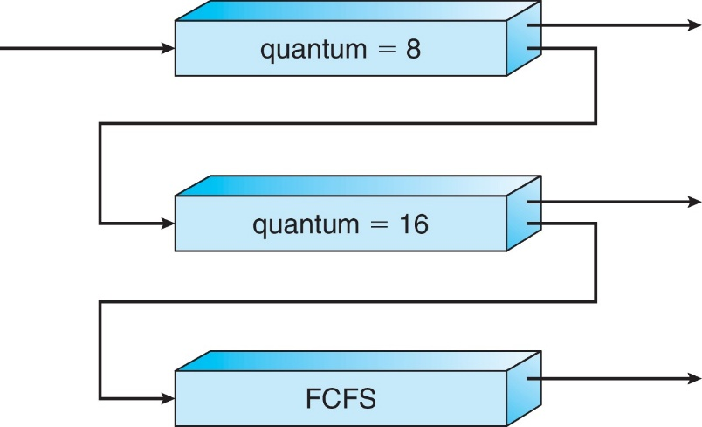
Example of Multilevel Feedback Queue
Three queues:
  Q₀ – RR with time quantum 8 milliseconds
  Q₁ – RR time quantum 16 milliseconds
  Q₂ – FCFS
Scheduling
  A new process enters queue Q₀ which is served in RR
    When it gains CPU, the process receives 8 milliseconds
    If it does not finish in 8 milliseconds, the process is moved to queue Q₁
  At Q₁ job is again served in RR and receives 16 additional milliseconds
    If it still does not complete, it is preempted and moved to queue Q₂

